Slide 1

PROJECT-2
Final Presentation

Slide 2
TEAM MEMBERS
Mohit Khadgi
Dinesh Bista
Anthony Atuche
Manish Shrestha
Sujata Koirala

Slide 3
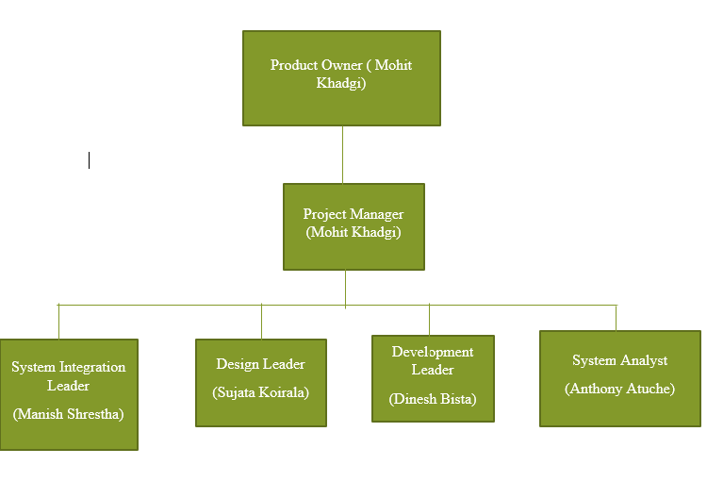
ROLES AND STRUCTURE

Slide 4
TOOLS AND TECHNIQUES
HTML/CSS
SQL
JAVA
PHP

Slide 5
TOPIC SUMMARY
Overview of the project, team and client
Project background
Demonstration of project outcome
Reflection of development process
Feedback from client

Slide 6
OVERVIEW OF THE PROJECT
Sprint backlog of 25 user stories created in the sprints.
Priorities were given to HIGH level incoming Product Backlog.
Feedbacks were noted.
All the user stories applied in the website.

Slide 7
OVERVIEW OF THE TEAM
Review meetings settled through messenger Video Call
Discussion on how to improve the project.
Everyone committed their tasks as given in statement of contribution.

Slide 8
OVERVIEW OF CLIENTS
Indicated radical aspects of the website to the client.
Discussion made through email.

Slide 9
PROJECT BACKGROUND
Domain Name
Association union inscription
Superlative images
Google Analytics

Slide 10
Sprint 1 - User stories
US2: As a staffing manager, I want to get an option for people to send resumes in website so that I can recruit new workers.
US5. As a user, I want contact details of a company in the Website so that I can contact them whenever needed.
US14.As a user, I want the website to be flexible so that I can select the works according to my interest and availability.
US4. As a user, I want a membership option so that the price will be cheaper for regular customer
US1: As a user I want an emergency booking system so that they can provide services anytime.

Slide 11
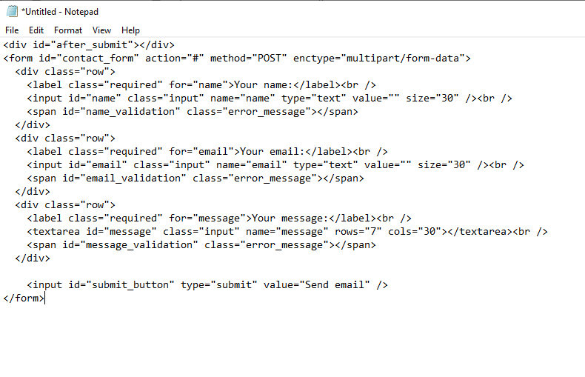
HTML Code for Contact form

Slide 12
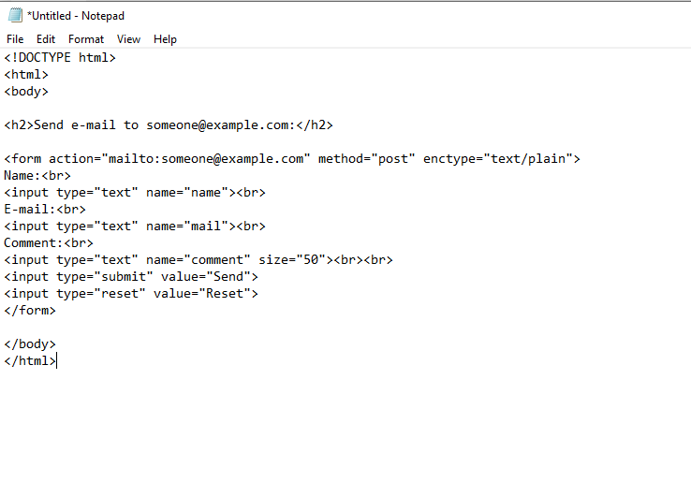
HTML code for sending email

Slide 13
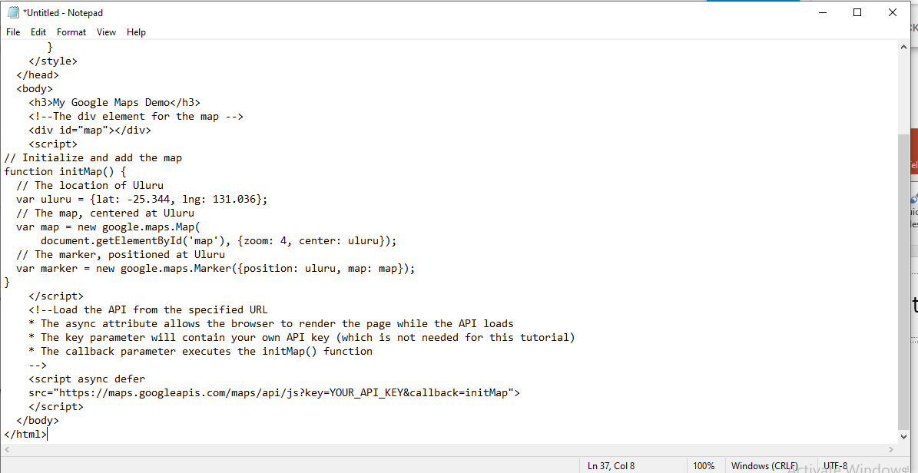
Adding a Google Map to our Website code

Slide 14
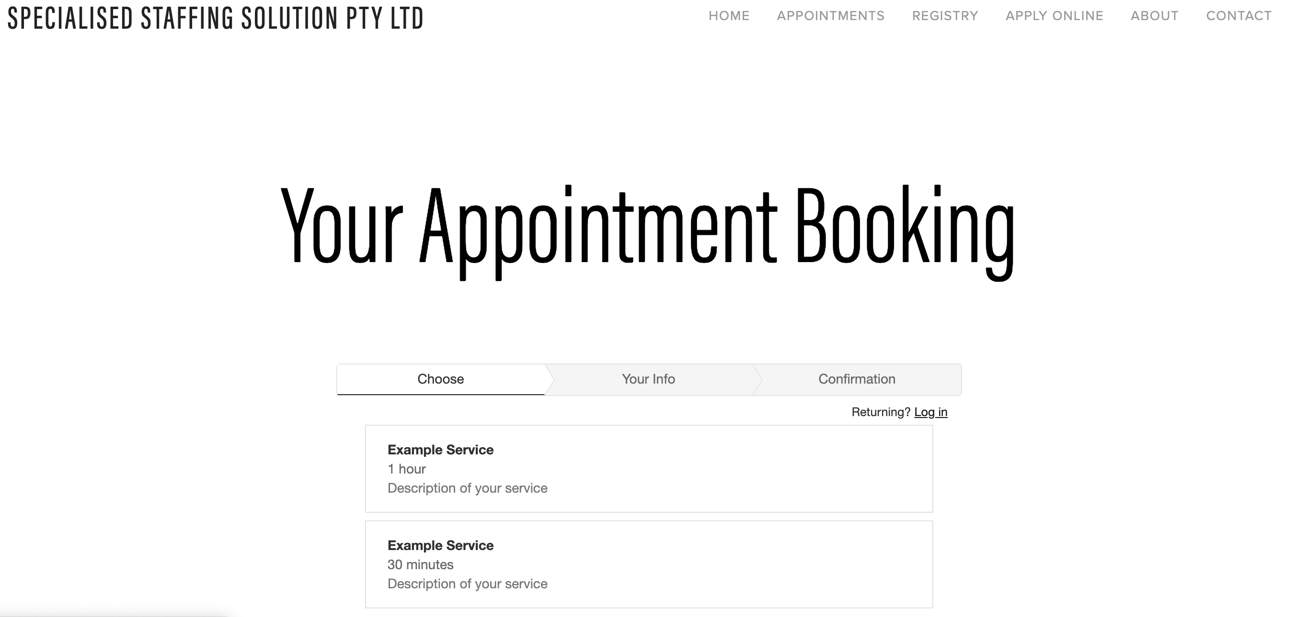
Booking Appointment

Slide 15
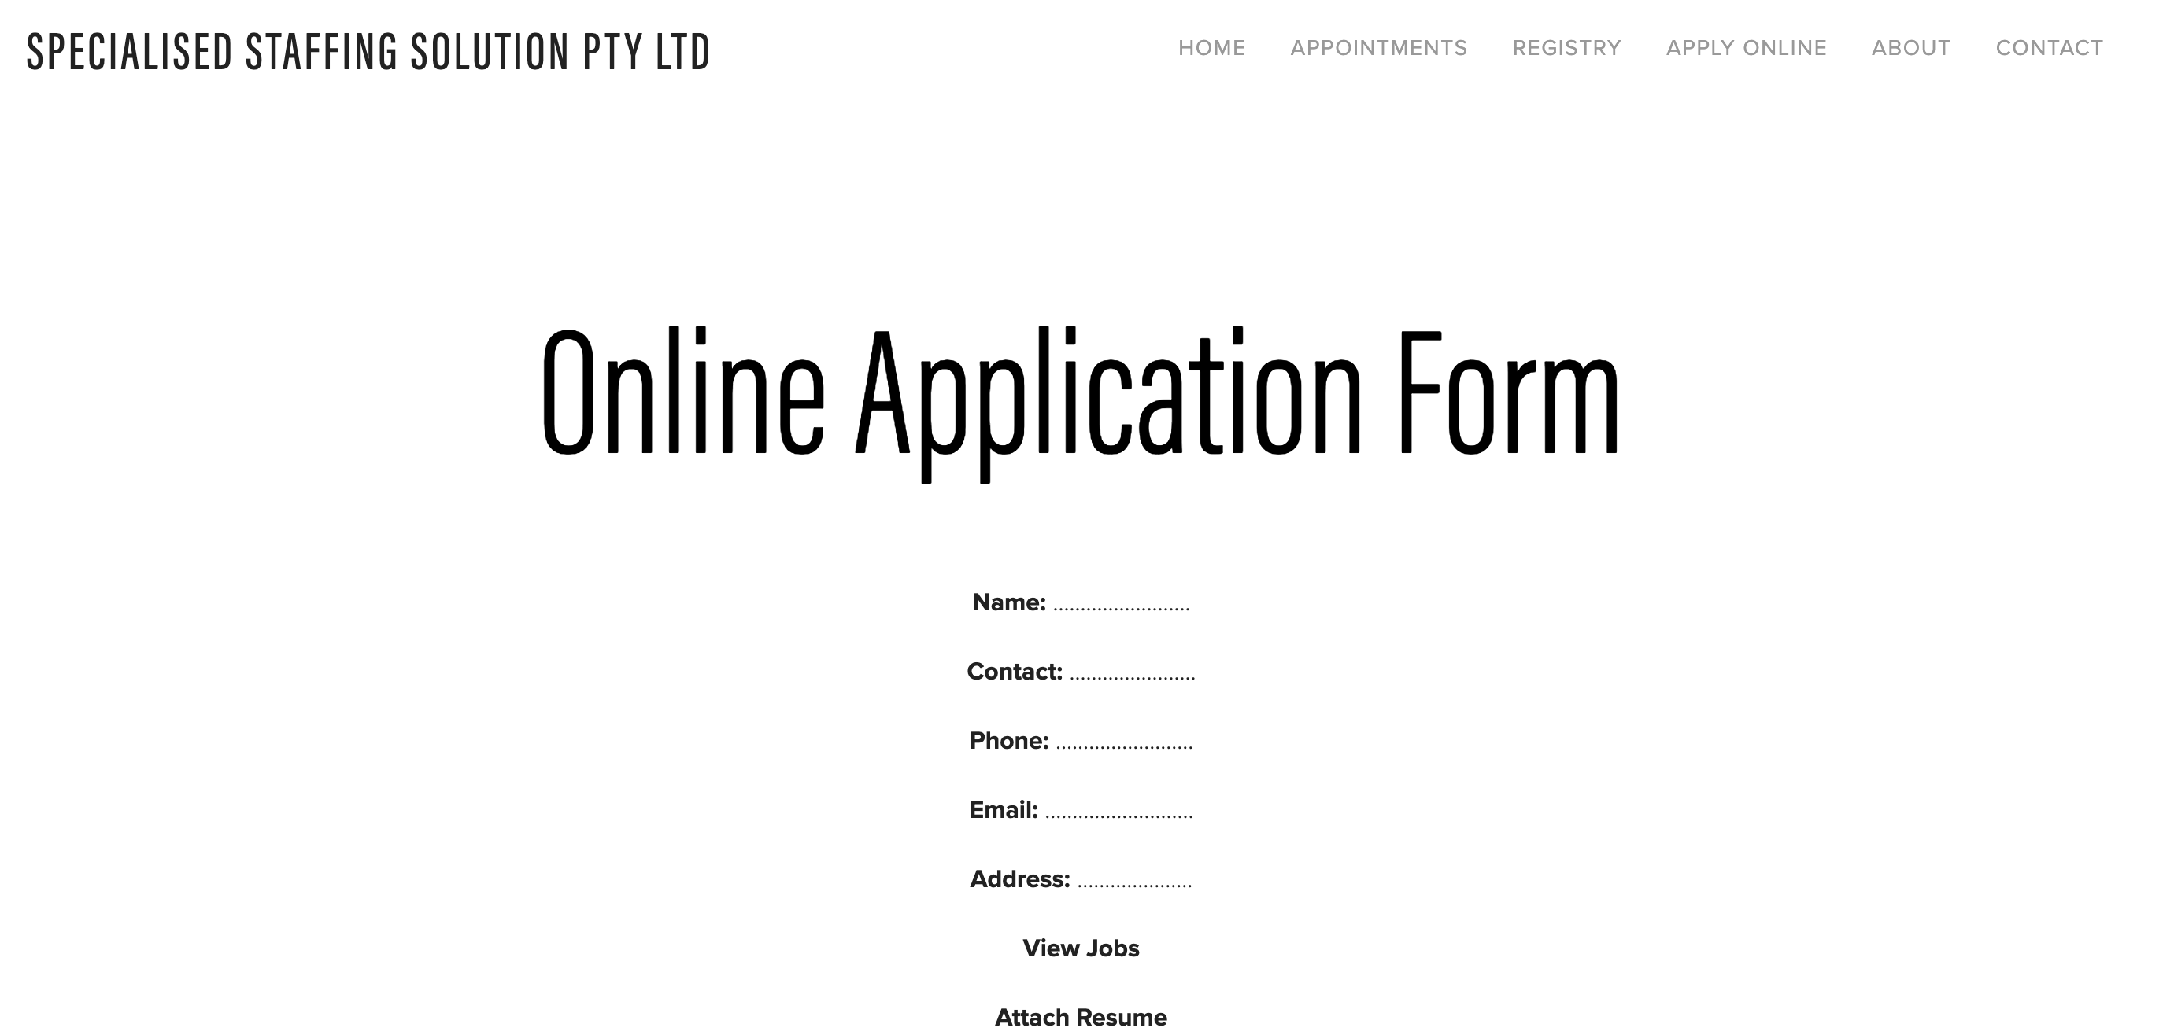
APPLICATION FORM

Slide 16
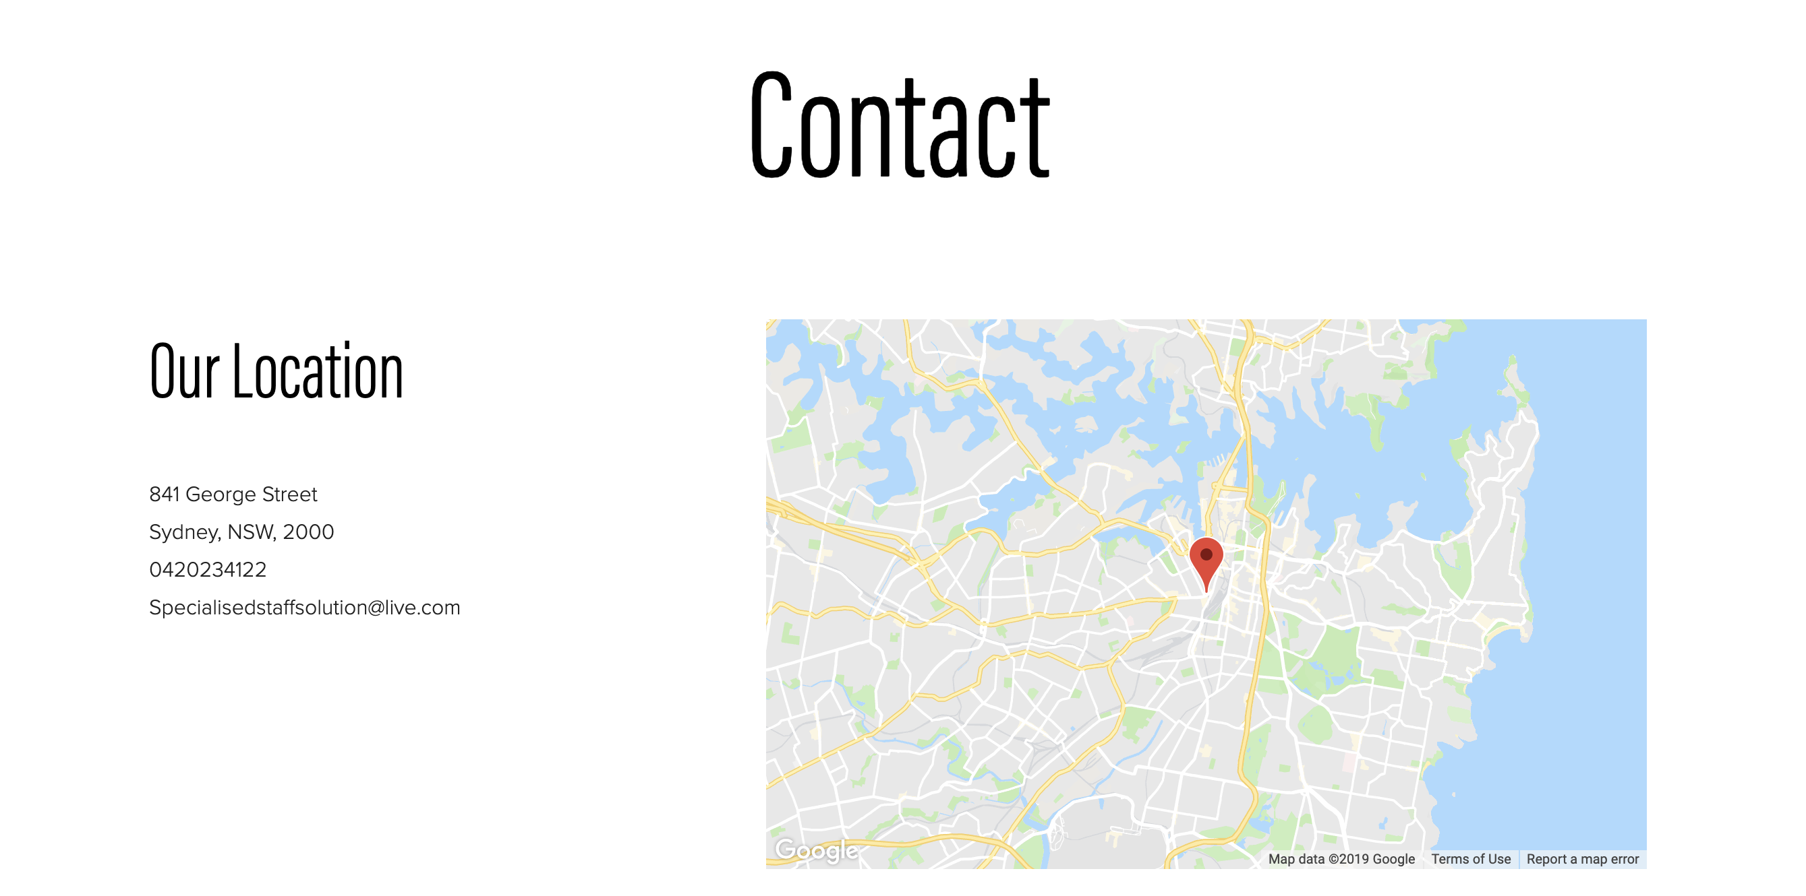
COMPANY LOCATION

Slide 17
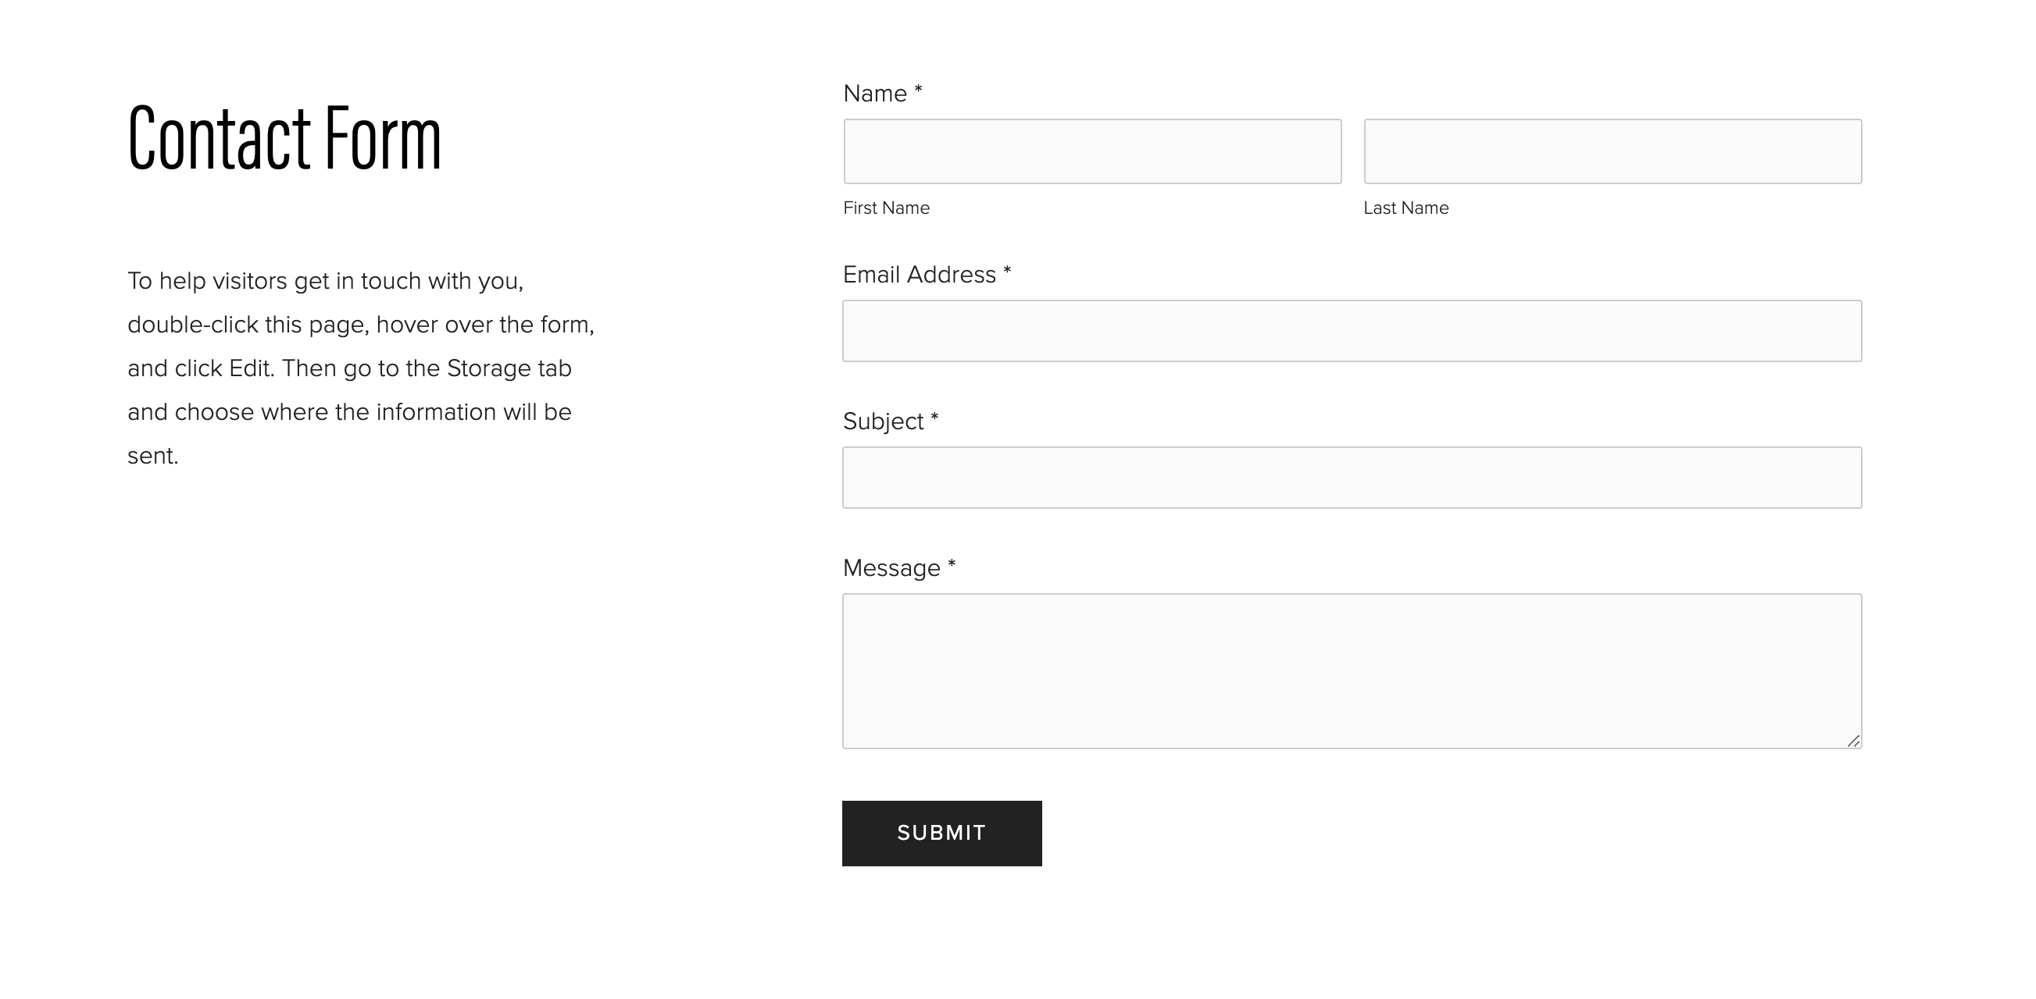
CONTACT FORM

Slide 18

Sprint 2 - User stories
US12: As a manager I want the website to have a login for staffs and employees. US11: As a staff management supervisor I want the website to be accessible by the employees to view their overall ratings and feedbacks.
US21: As a user I want to provide personal feedback so that company would know about their competition in the market.
US18: As a user, I want to register my details in the system, so that I do not have to provide my information every time I’m using the system.
US25: As a user, I want a proper website to book a service fast without any additional charges.
.

Slide 19
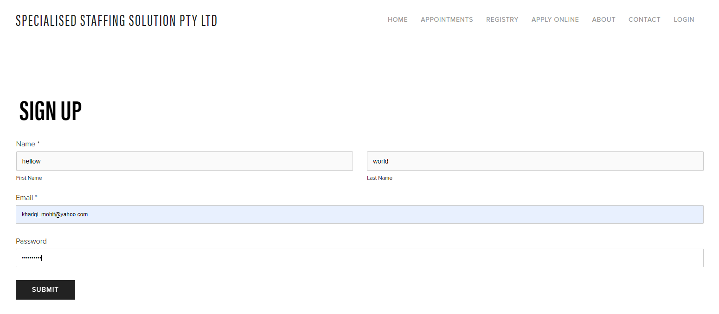
Sign Up Page

Slide 20
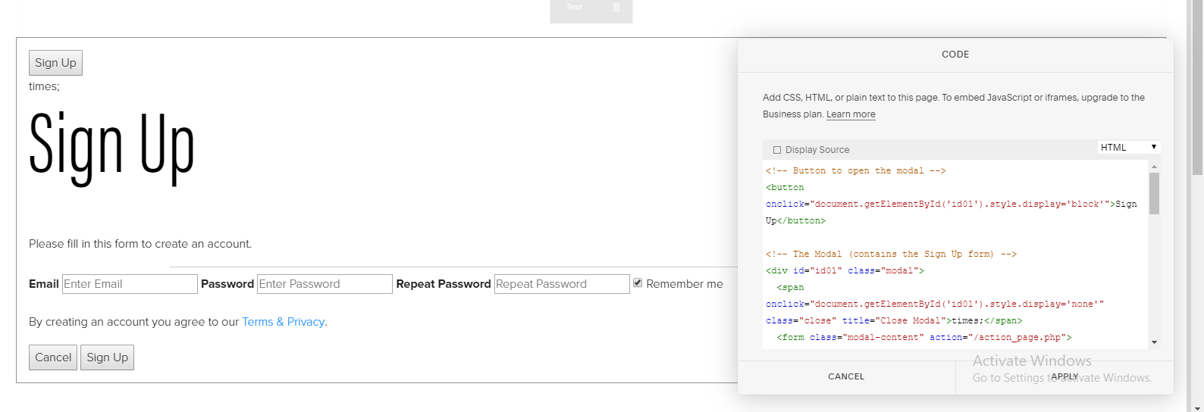
With codes

Slide 21
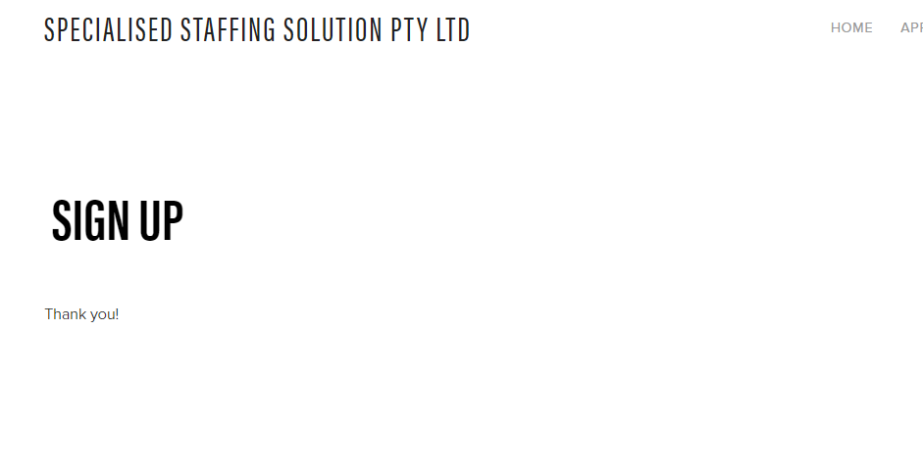
Confirmation

Slide 22
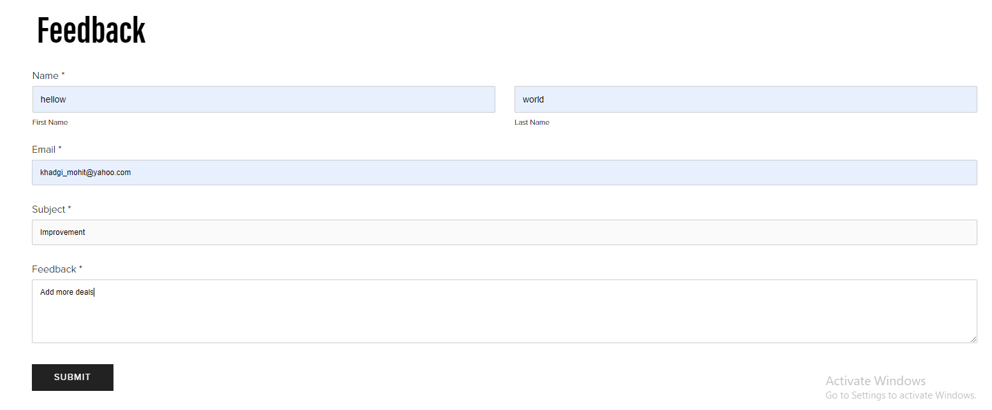
Feedback

Slide 23
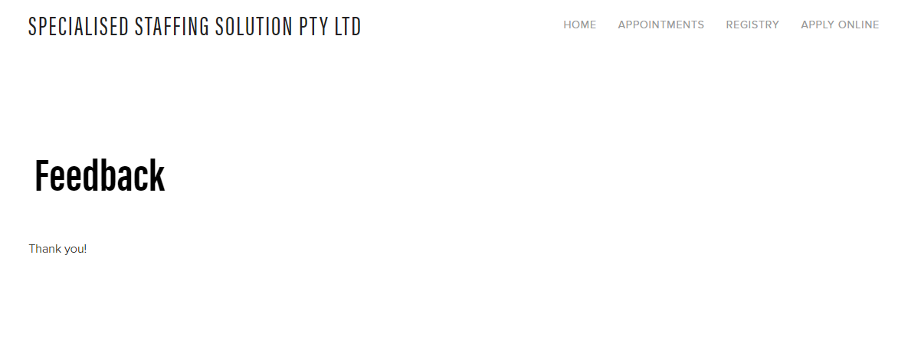
Confirmation

Slide 24
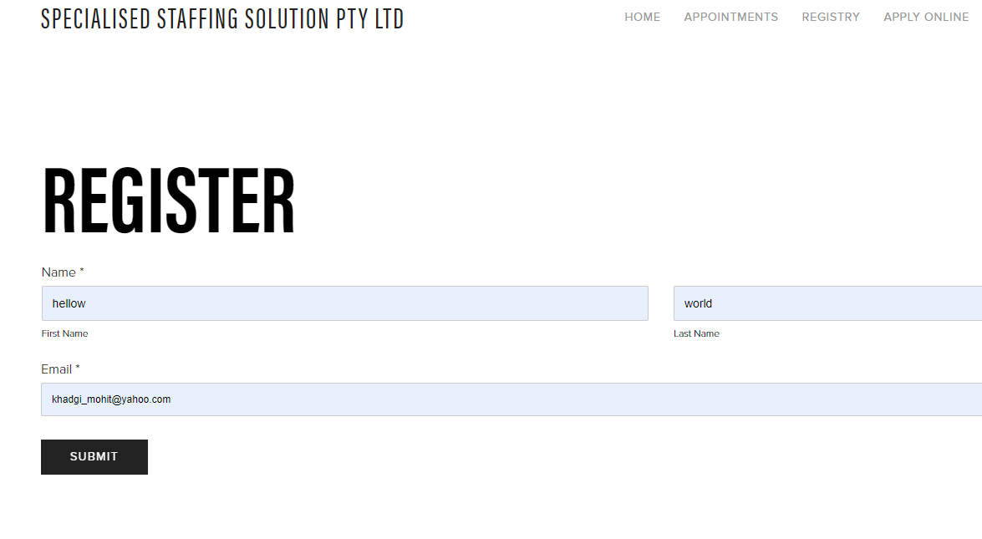
Register

Slide 25
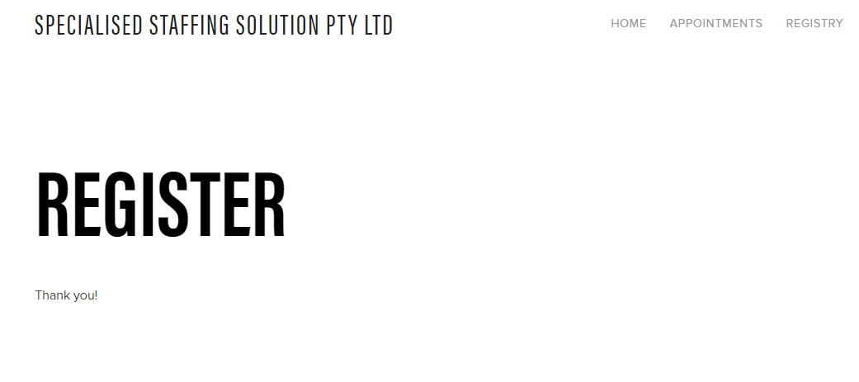
Confirmation

Slide 26
DEMONSTRATION OF PROJECT OUTCOME with user stories FOR SPRINT-3
US6: As a user, I want to view map of a company in the website so that I can get the direction directly.
US16: As a user I want to have the system which is easily adaptable according to requirement changes and suitable on any screen design.
US27: As a COE, I want to create a system to help workers to communicate via messages and emails letting them know about their job as soon as possible.
US29: As a user, I want 24/7 costumer service so that I can contact the office anytime.
US33: As a user, I want to ensure that, I will get notification regarding the job. Also, I should be able to check it online what’s happening during the job.

Slide 27
Home Page
This is the Homepage of our website where people can easily access to our services. They can also contact via phone or email us with easier and simple way by clicking shortcut key at top right.

Slide 28
Location
This is our Location Page where client can easily locate us with in their territory and view our opining hours.

Slide 29
Privacy Policy
This is our privacy policy page where client can learn about our polices that will eventually make the deal easier.

Slide 30
About Us
This is our About Us page where we have included our online features to our clients and the services, we provide to them.

Slide 31
Apply Online
To Apply online people can go to our homepage and scroll down to fill the form and attach their resume.

Slide 32
Enquires and Update
Our service is always there to help guide clients. They can easily access to our website and contact us for Enquires and Update.

Slide 33
Sprint 4
US9: As a user, I want my payment details to be private so that I can save my information.
US10: As a user, I want to have a website where I can hire staffs to be sent to work on different occasions as requested by our clients.
US15: As a user I want to rate the employee that works for us according to the feedback of the customers so that he works with his full commitment.
US17: As a user I want pre-booking system so that good services can be received.
US23: As an owner I want to have the screen of the system to be simple and clear so that there will be no error while logging to the system.

Slide 34
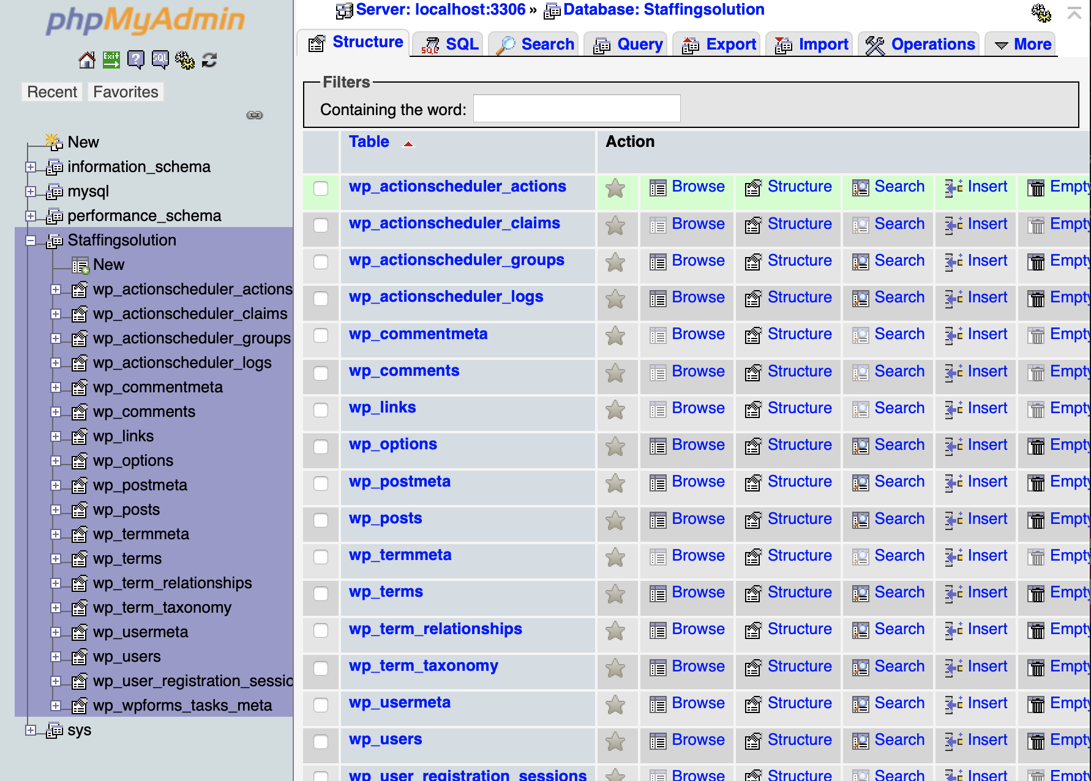
Data Base

Slide 35
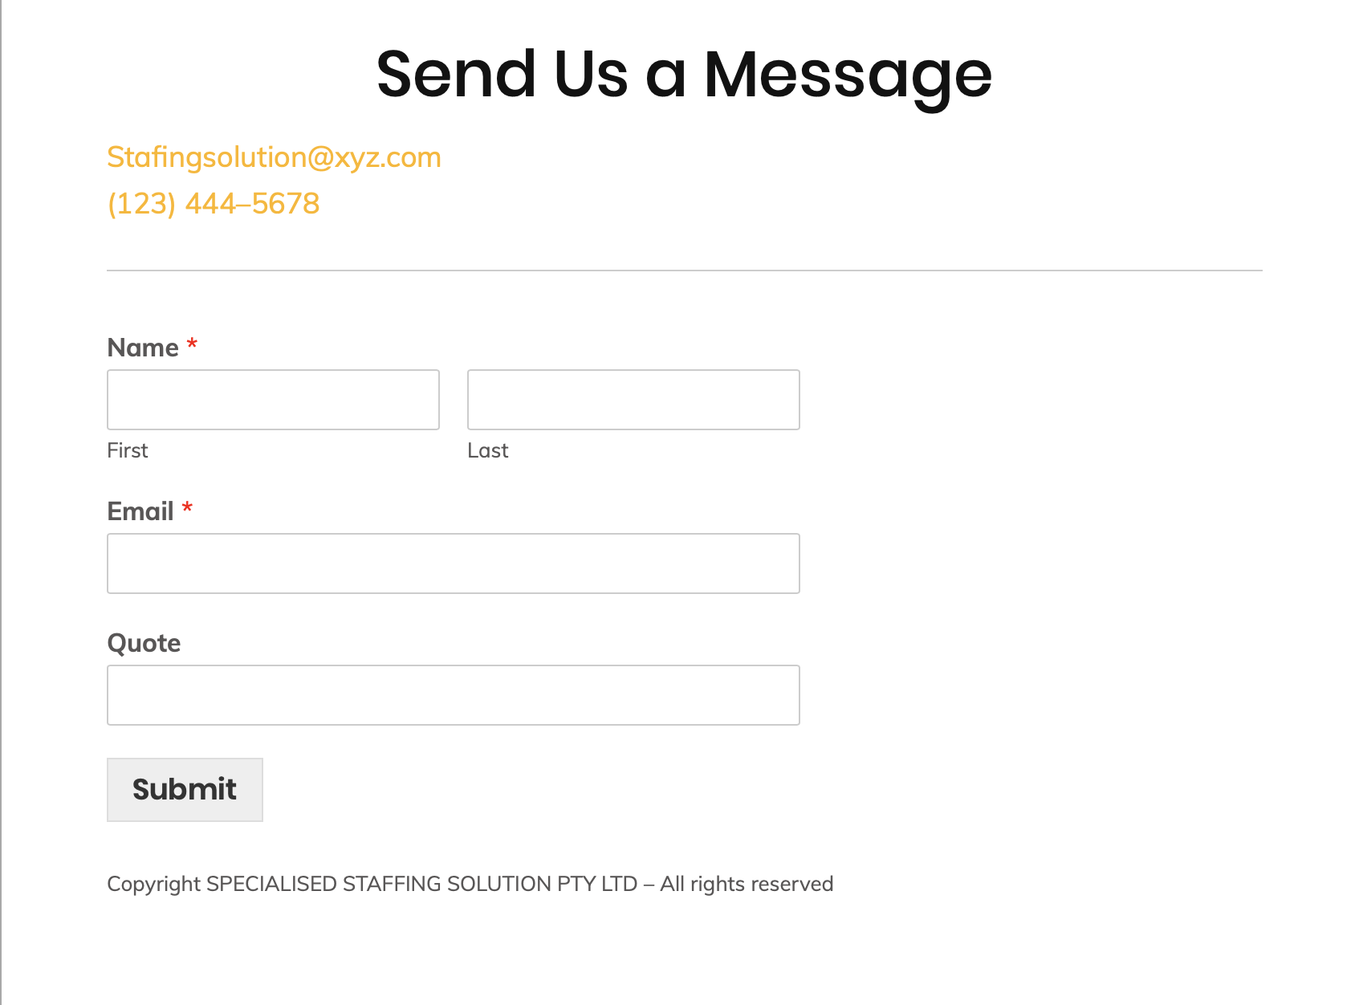
Feedback

Slide 36
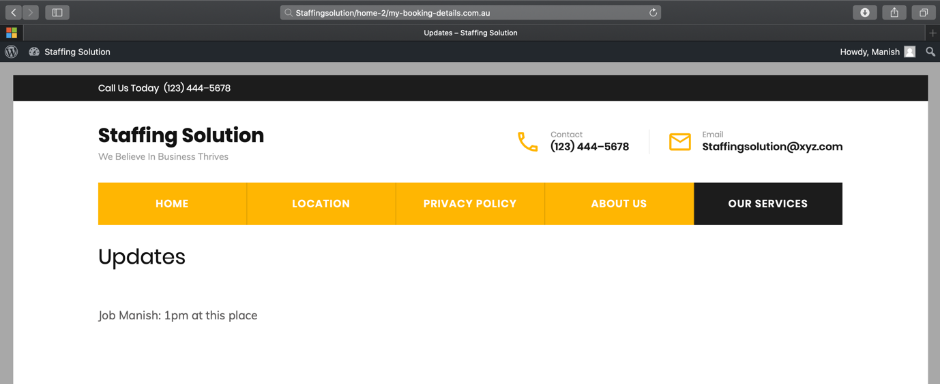
Updates

Slide 37
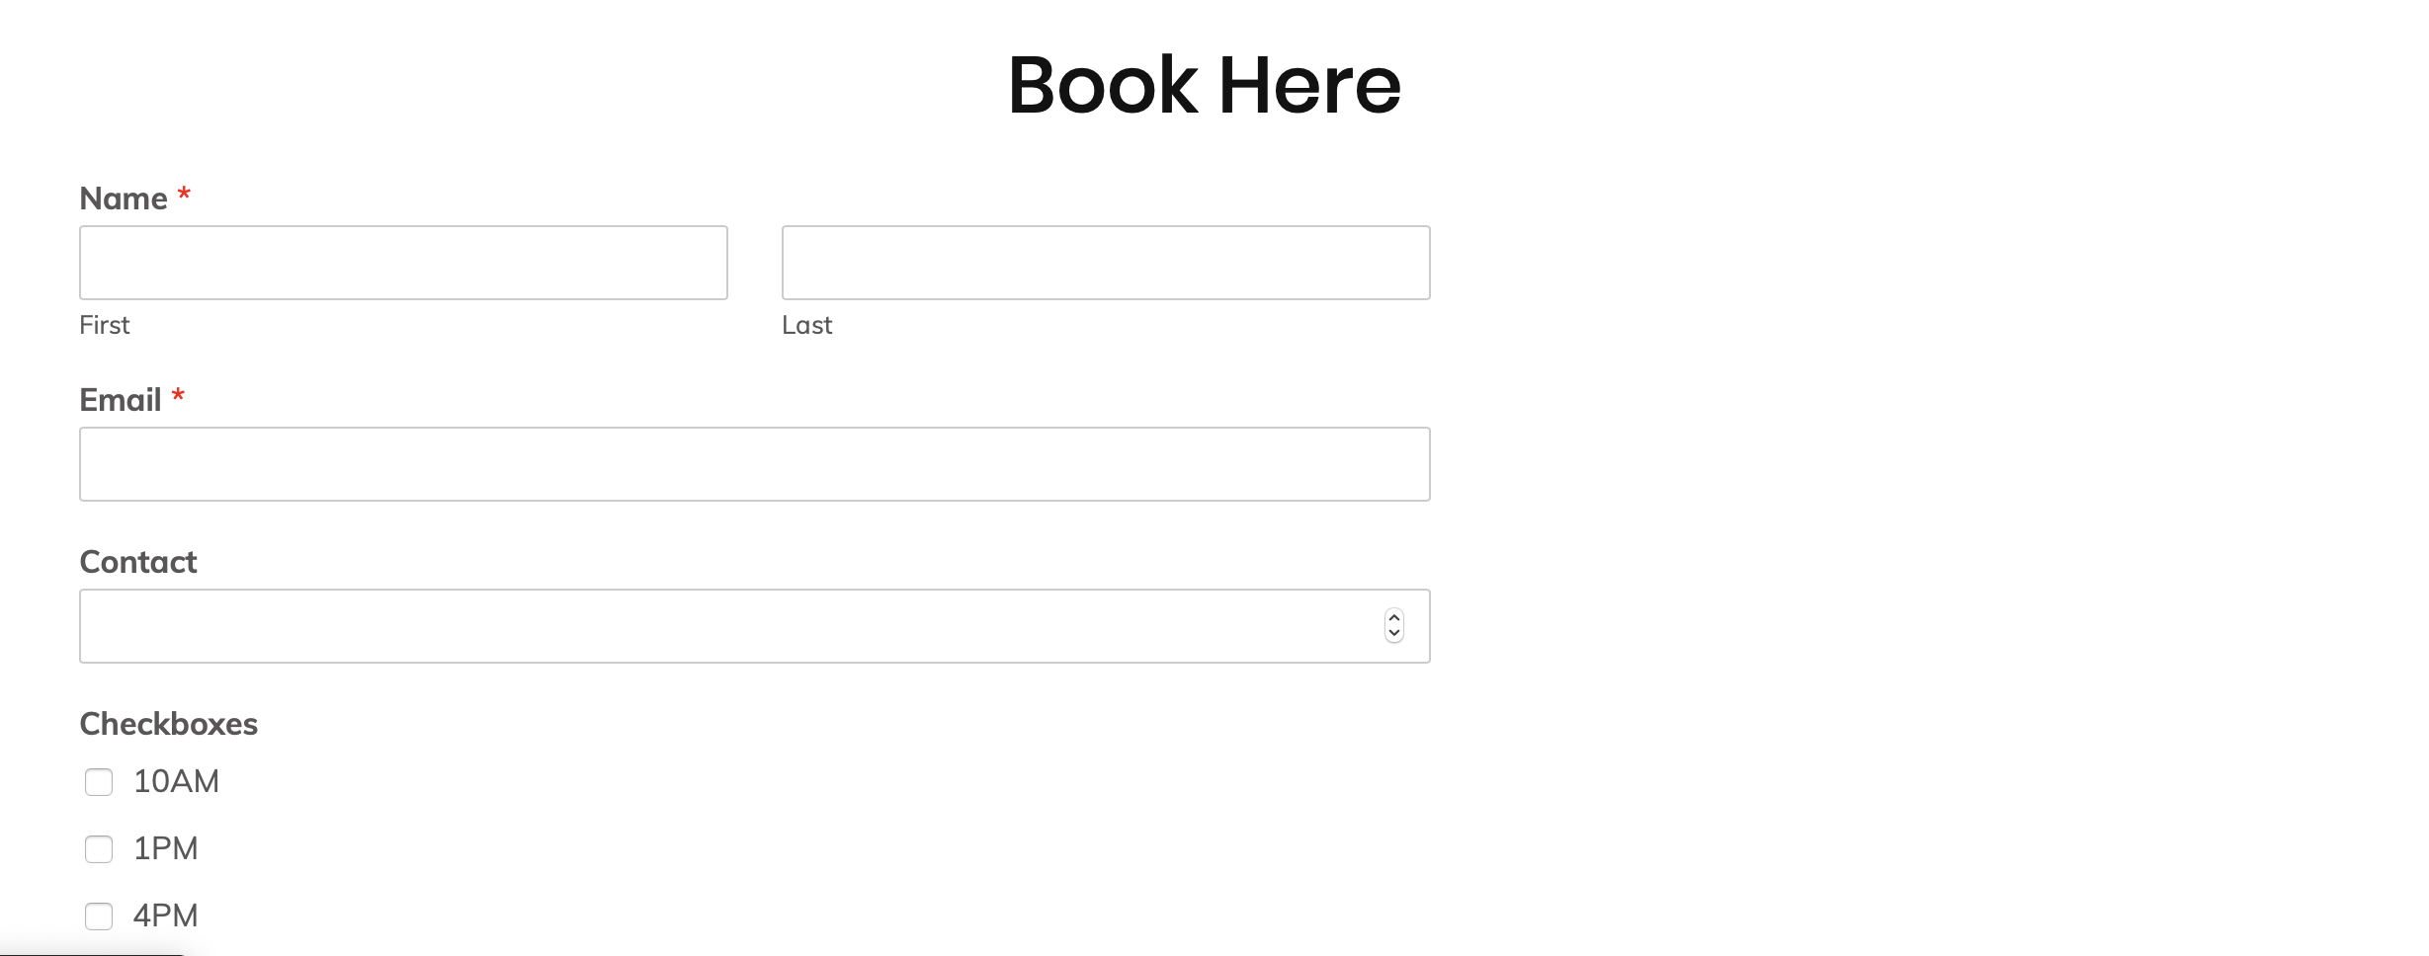
Booking

Slide 38
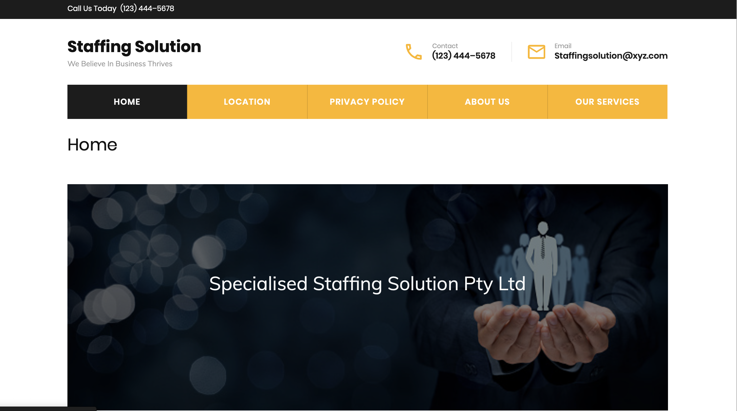
Website View

Slide 39
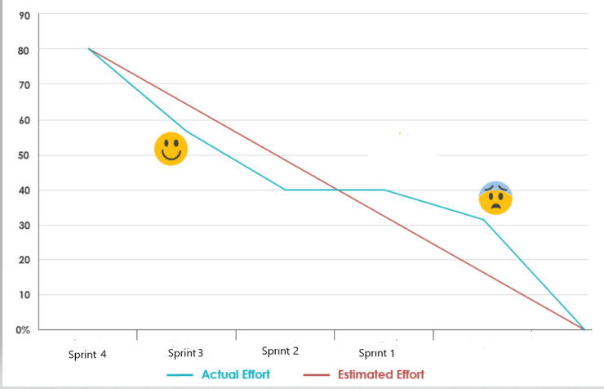
Burn down chart of sprint 4

Slide 40
Sprint 5
US19: As a user I want to login to the system so that I can get information regarding the services.
US26: As a COE, I want to create a website to advertise the business creating ads and promotions.
US28: As a user, I want a fastest and guarantied service with convenient time schedule.
US22: As a user, I want to have the system which will accept any payment options such as credit cards, debit cards, PayPal, etc.
US31: As a user, I want to create an account in a system to save my information so that it will be easier for me to provide my details for multiple bookings.

Slide 41
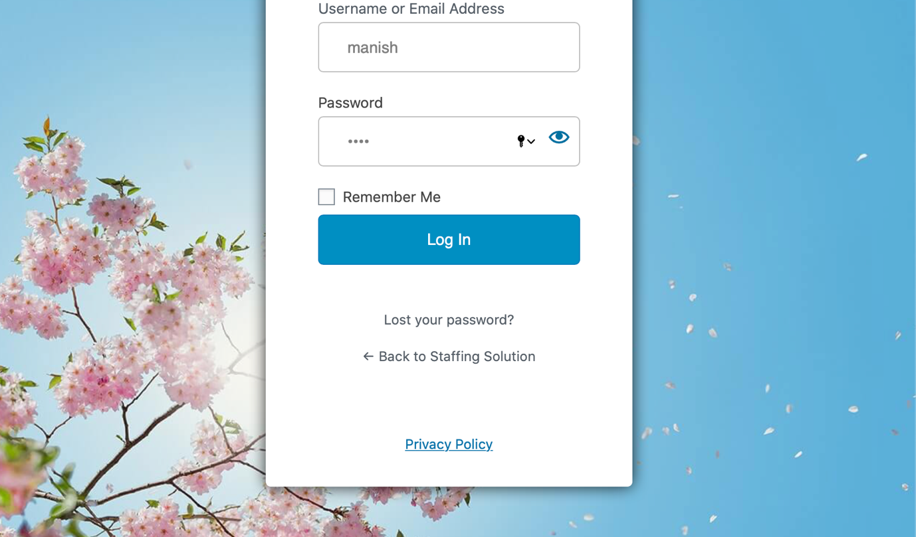
Login Page

Slide 42
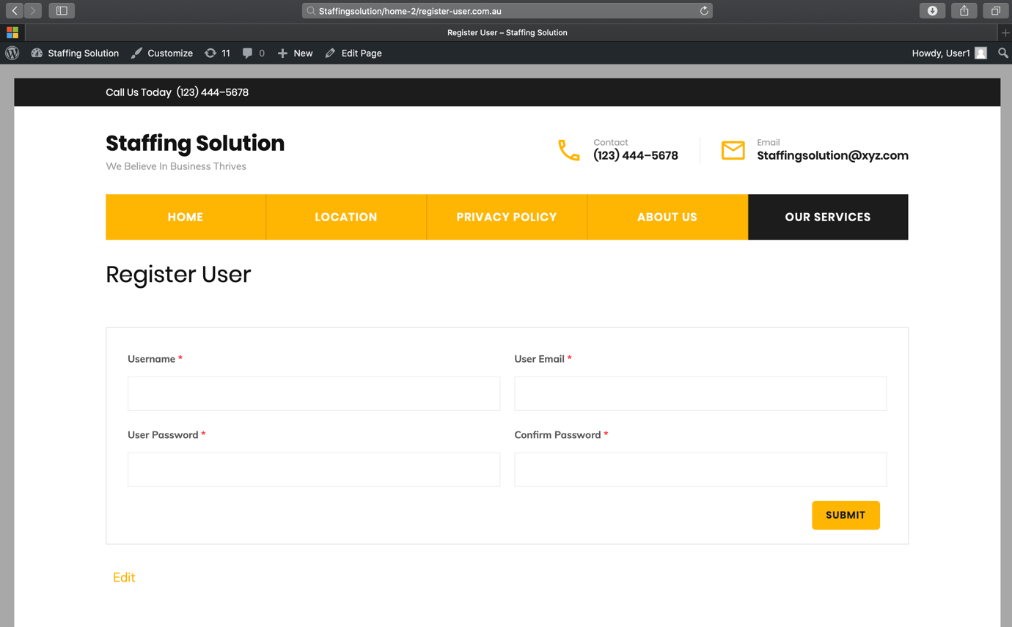
Registration

Slide 43
Updates

Slide 44
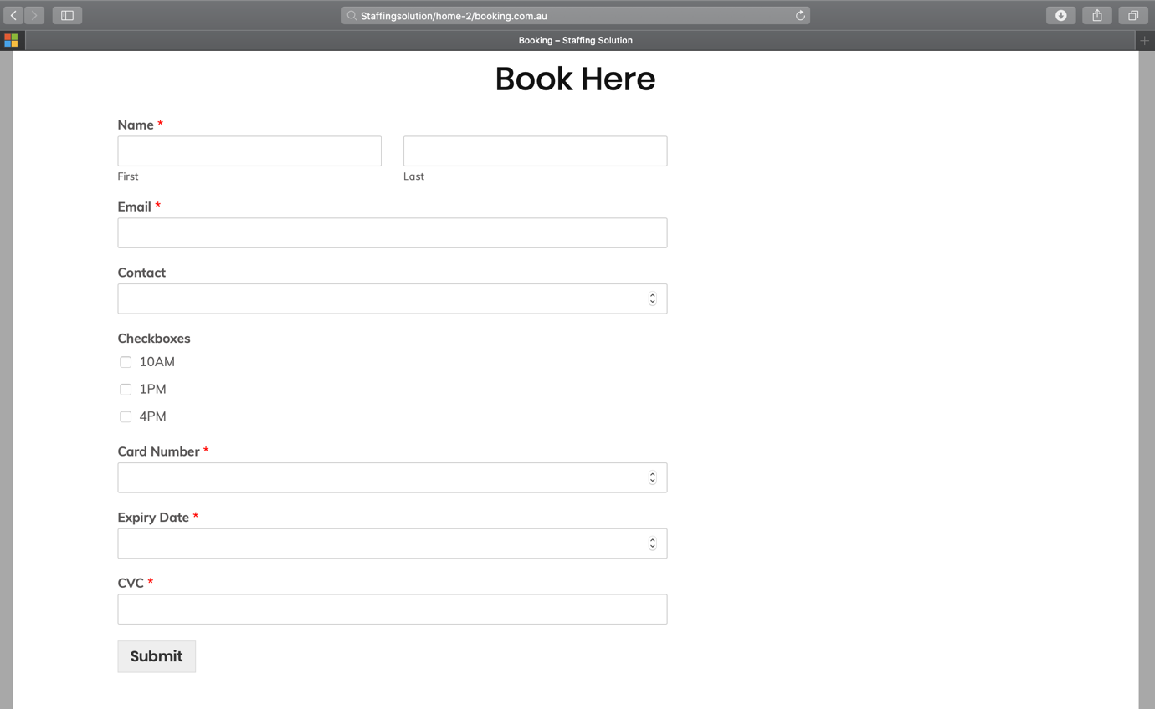
Booking and Payment

Slide 45
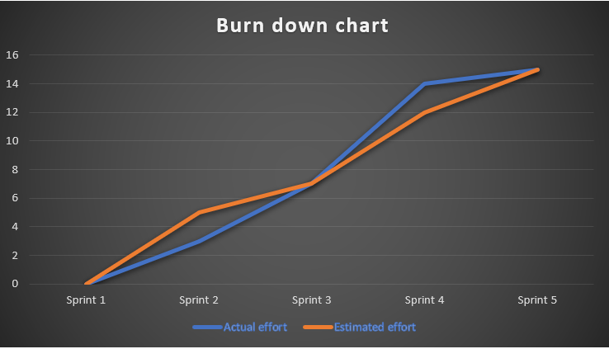
Burndown chart of sprint 5

Slide 46

REFLECTION OF DEVELOPMENT PROCESS

Slide 47
What went well ?
The joint effort between the group worked out in a good way.
The issues in the previous sprint were as often as possible examined with the goal that we will be guaranteed not to rehash them.
The assessed time for finishing of undertaking was close.

Slide 48
What could be improved?
We have to focus on the subtleties all through the undertaking.
We have to cover all the necessities as gave in the task portrayal.
The documentation should be seen once in detail by the entire group previously accommodation so there is less possibility of blunders.
The documentation ought to be settled in any event daily before due dates so that the late submission punishment won't be applied.
The team should be task every task seriously and must be there in each gathering.

Slide 49
What can we do?
We have to focus on the improvement.
We likewise need to determine the in-scope prerequisites for the undertaking to encourage making the work breakdown structure.
We have to get ready for any potential dangers thinking about elective methodologies.

Slide 50
What is not in our control?
Power cut off during online meetings.
Loss of data.

Slide 51
FEEDBACKS
Use of high level informations.
Some incoming product backlog changed from low to high as per discussion with the client.
Clients impressed with the project.

Slide 52
CONCLUSION AND FUTURE WORK
Discussion of future work through meeting.
Maintain the website
Exploration of new ideas to improve the project.

Slide 53


ANY QUESTIONS?
…

